Slide 1

Experimental Design
BIA 654
Hoboken Housing Price
Professor C. Lee
Students: Gao Shihuan, Sharma Abhay & Presberg Raphael
Date: 05/01/2018

Slide 2
Background and Motivation
Hoboken Area is a hot real estate market
International Students after graduate
Office workers in new york city
Hoboken market trends indicate an increase of $133,000 (20%) in median home sales over the past year
Important life choice to buy a home place
Meet housing conditions
Financial ability

Slide 3

Data Source
Hoboken real estate prices information from Kaggle
Over 1000 variables and 80 attributes
Each attribute influences on the outcome of a single real estate price

Slide 4
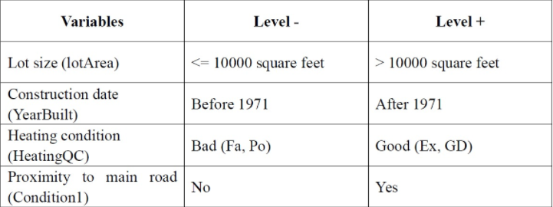
Experiment
A designed experiment applies a treatment to individuals and attempts to isolate the effects of the treatment on a response variable.
An observational study measures the characteristics of a population by studying individuals in a sample, but does not attempt to manipulate or influence the variables of interest.
Observational study vs Experiment
Experiment study
Observational
TREATMENT
What we did
Factor analysis creation: 4 factors
Response: the house final sales price in dataset
Random factor design of 4 factors on 16 runs
2 replications (32 runs in total)

Slide 5
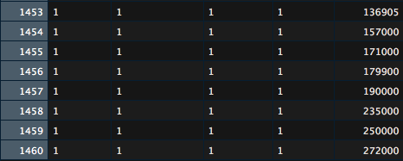
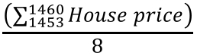
Conducting the Experiment
Split the dataset to have 2 replications
1st experiment: Dataset
(50% of the initial dataset)
Initial
Dataset
2nd experiment: Dataset
(the other 50% of the initial dataset)
Case with all the factors equal to the high level (1 run)
8 records answering the requirements
8 different house price
we calculate the mean of these house prices
$$\frac{\left(\sum_{1453}^{1460}{House price}\right)}{8}$$
So the mean price of these houses is 199k$
Factor 1 | Factor 2 | Factor 3 | Factor 4 | Response
1 | 1 | 1 | 1 | 199k$

Slide 6
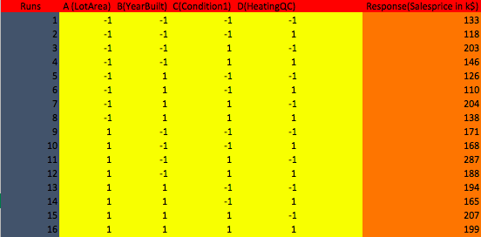
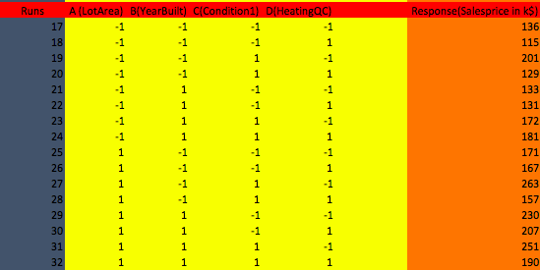
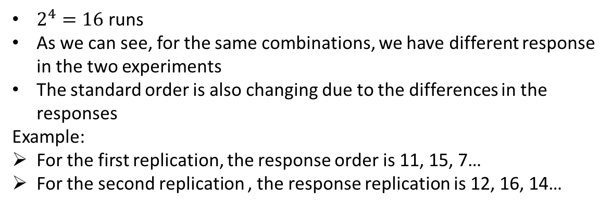
Results: sales price
1st replication ➔ 16 runs
2nd replication ➔ 16 runs
$2^{4}=16$ runs
As we can see, for the same combinations, we have different response in the two experiments
The standard order is also changing due to the differences in the responses
Example:
For the first replication, the response order is 11, 15, 7…
For the second replication , the response replication is 12, 16, 14…

Slide 7
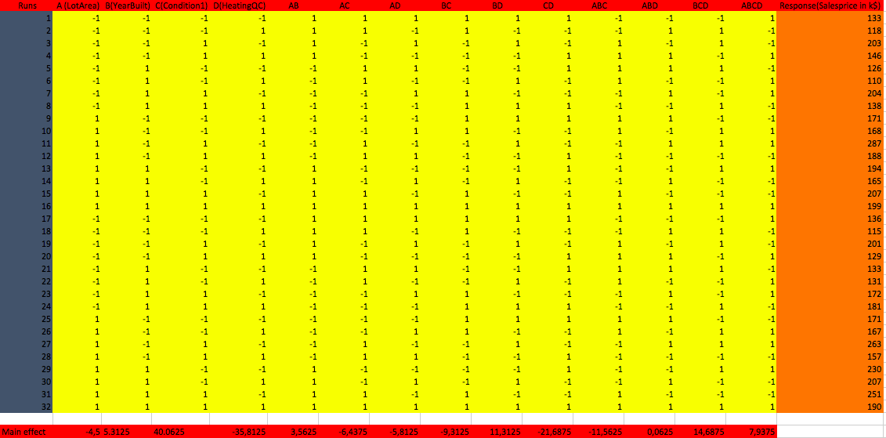
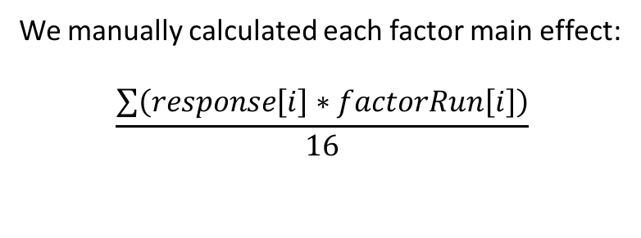
Full Factorial Design
We manually calculated each factor main effect:
$$\frac{\sum{\left(response\left[i\right]∗factorRun\left[i\right]\right)}}{16}$$

Slide 8
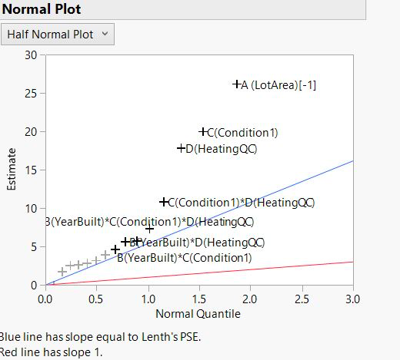
Half Normal Plot
The half normal plot is used for grouping of factors into 2 categories: important & not important
Analysis
We can see here that only 5 factors are significant:
Above the blue line ➔ significant
Very close to the blue line ➔ not significant

Slide 9
Pareto Plot Estimate
Significant effect
Our significant effects are:
Factor A ➔ Lot Area
Factor C ➔ Condition1 (close to main road or no)
Factor D ➔ Heating condition
Factor CD ➔ Condition1*HeatingQC
Factor BCD ➔ YearBuilt* Condition1* Heating QC

Slide 10
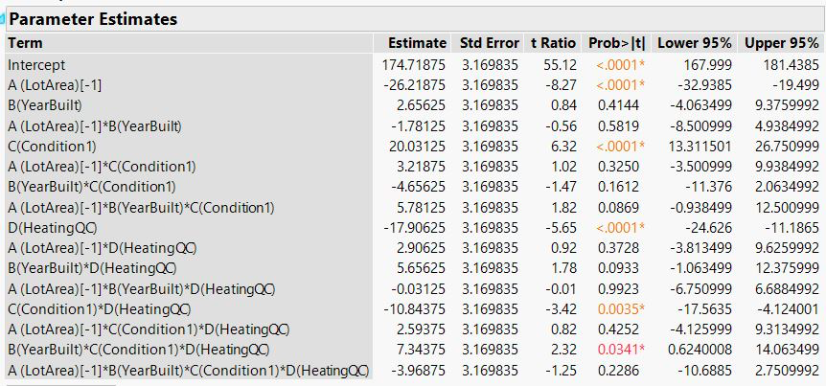
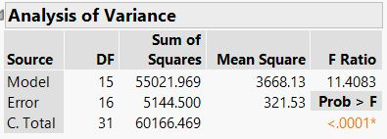
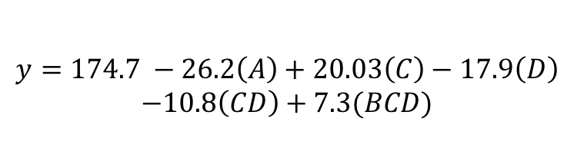
Parameter Estimates
Significant effects
We will only use the estimate of our significant effects to build the regression equation.
Regression Equation
ANOVA
Reminder: our significant effects are A, C, D, CD, and BCD
$$y=174.7 −26.2\left(A\right)+20.03\left(C\right)−17.9\left(D\right)$$
$$−10.8\left(CD\right)+7.3(BCD)$$

Slide 11
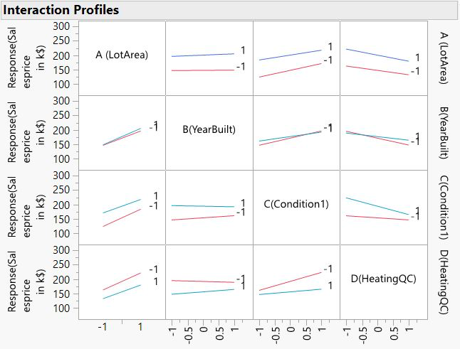
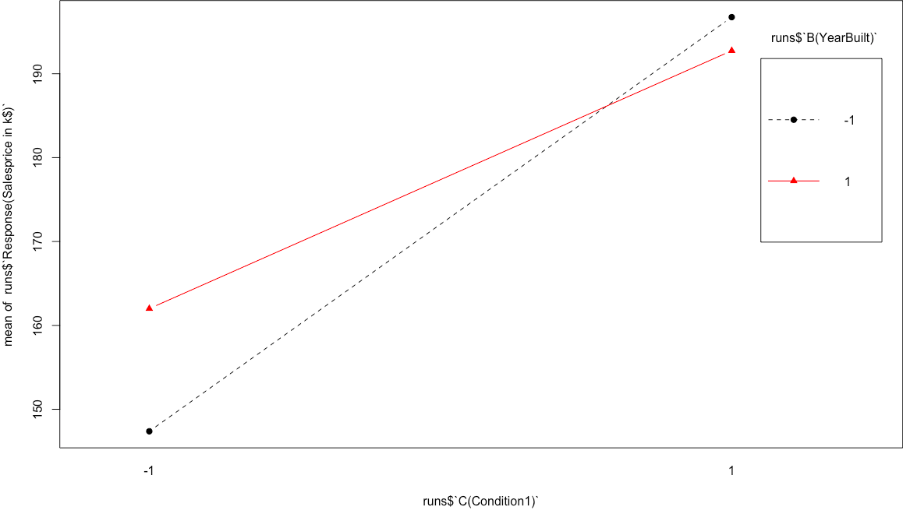
Effects
Global
Here is our interaction plots between our factors A, B, C and D
Example: Interaction plot between B and C
Houses are the most expensive when they have been built before 1970 and when they are in a good neighborhood
Houses are the less expensive when they have been built before 1970 and when they are far from a main road

Slide 12
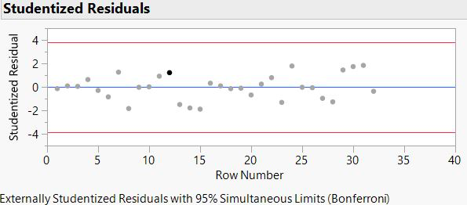
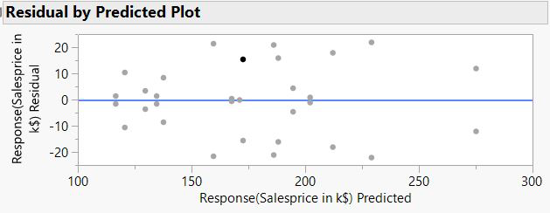
Residual Analysis
Studentized Residuals
It is a form of a Student's t-statistic, with the estimate of error varying between points.
Residuals response by predicted response

Slide 13
Conclusion
The top 3 signifiant affects are the size of the house, convenienced to the main road and the heating condition of the house.
Surprisingly in Hoboken, looking for a satisfied lot size house cost a less than other housing conditions.
If one have limited financial ability and willing to buy a house in Hoboken. He can still looking for a brand new building but lies on somewhere that far away from city center.

Slide 14
Professor C. Lee
Students: Gao Shihuan, Sharma Abhay & Presberg Raphael
Date: 05/01/2018

